Slide 1
MACHINE LEARNING AS A SERVICE
INFO7390 15974 Advances Data Sci/Architecture
By
Abhinav Tiwari
Dharit Shah
Nilesh Nerkar
(Team 2)

Slide 2
Agenda
Machine Learning Pipeline
MLAAS
How MLaaS make it easy?
Available Machine Learning Services
Azure ML Studio
What is Amazon SageMaker?
H2O (AutoML)
Titanic Dataset with Azure ML Studio, AWS and H2O

Slide 3
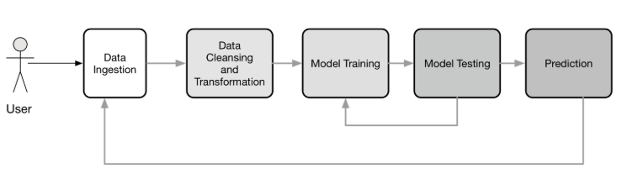
Machine Learning Pipeline

Slide 4
Machine Learning As A Service
The same as SaaS or BaaS solutions, machine learning as a service platforms are intended to handle nearly all matters connected with infrastructure
Developers are not obligated to messing with model training and evaluation, as well as worry about further cloud-based predictions
MLaaS makes it easy and automate the pipeline depending upon the service which we use

Slide 5
Available Machine Learning Services
Azure Machine Learning
Amazon Machine Learning
H2O AI
Databricks
Google Prediction API
IBM Watson
TensorFlow

Slide 6
What is Azure ML Studio?
Azure ML is a visual interface contributing to model building and training, as well as choosing algorithms to apply
The service itself is focused around the ML Studio framework that allows you to create modular solutions

Slide 7
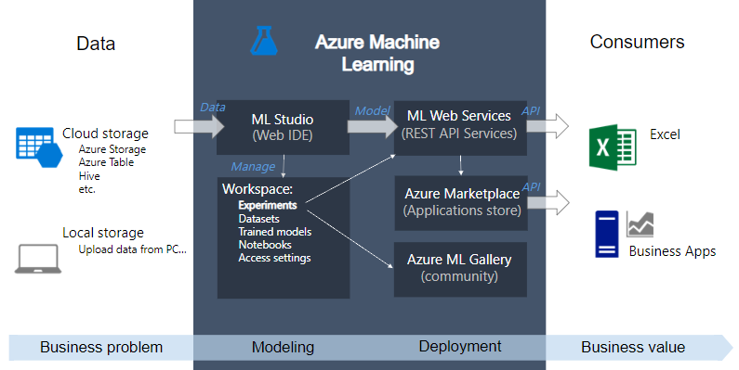
Overview Azure ML Studio

Slide 8
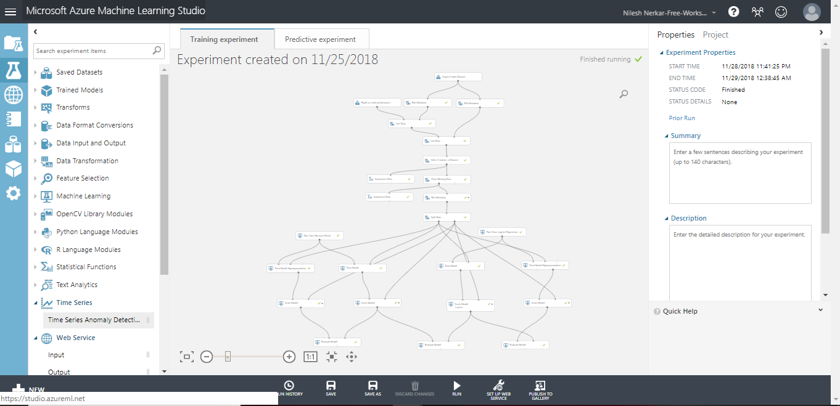
Azure ML Studio Demo

Slide 9
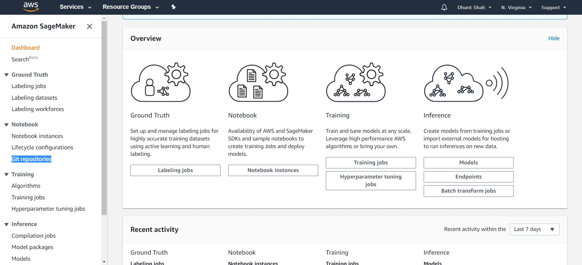
What is Amazon SageMaker?

Slide 10
Amazon SageMaker Features
Build
Build highly accurate training datasets
Managed Notebooks for Authoring Models
Built-in, High Performance Algorithms
Broad Framework Support
Broad Framework Support
Train
One-click Training
Automatic Model Tuning Broad Framework Support
Train Once, Run Anywhere
Deploy
One-click Deployment
Automatic A/B Testing
Fully-managed Hosting with Auto Scaling

Slide 11
Amazon SageMaker Demo

Slide 12
H2O AI Description

Slide 13
H2O AI
Pros:
Model Selection
Model Validation

